Slide 1


Company Overview
2025
Preferred Supplier Event
Notes:
Insert client logo

Slide 2
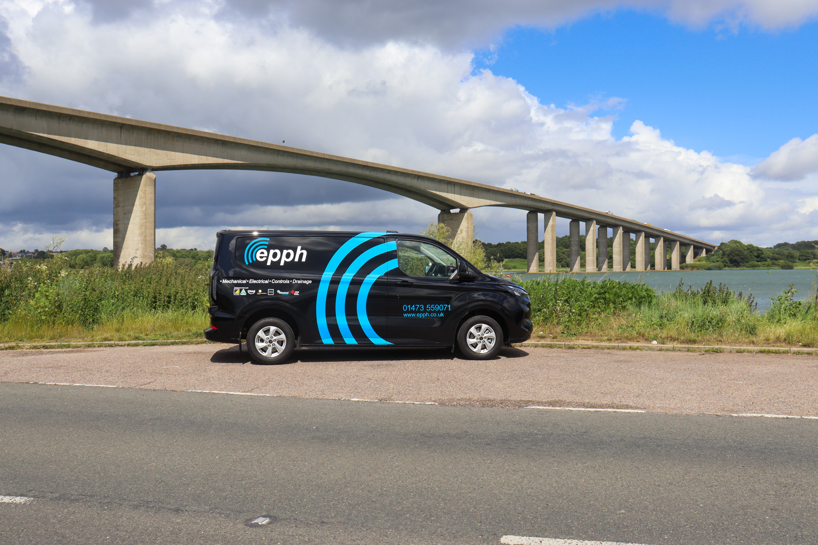
Company History
Established in 2012 as a local MEP specialist, EPPH has blossomed into a comprehensive building services champion. Our unwavering dedication to exceptional customer service and building long-lasting relationships has fuelled our journey, empowered by a team renowned for their expertise and unwavering commitment.​
Today, we proudly offer a comprehensive range of services encompassing Mechanical, HVAC, Electrical, and Drainage services, serving as your one-stop shop for building service needs across the UK. From our southern base in East Anglia to our northern hub in Durham.​

Slide 3

Our core services

Slide 4


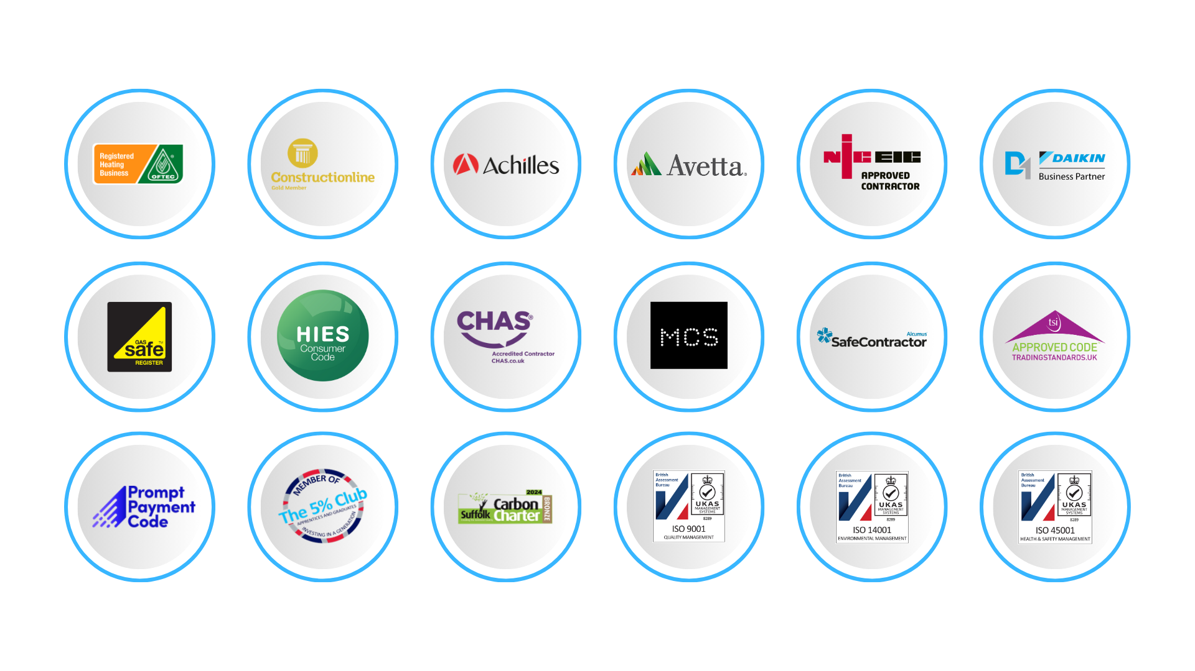
Our Accreditations

Slide 5
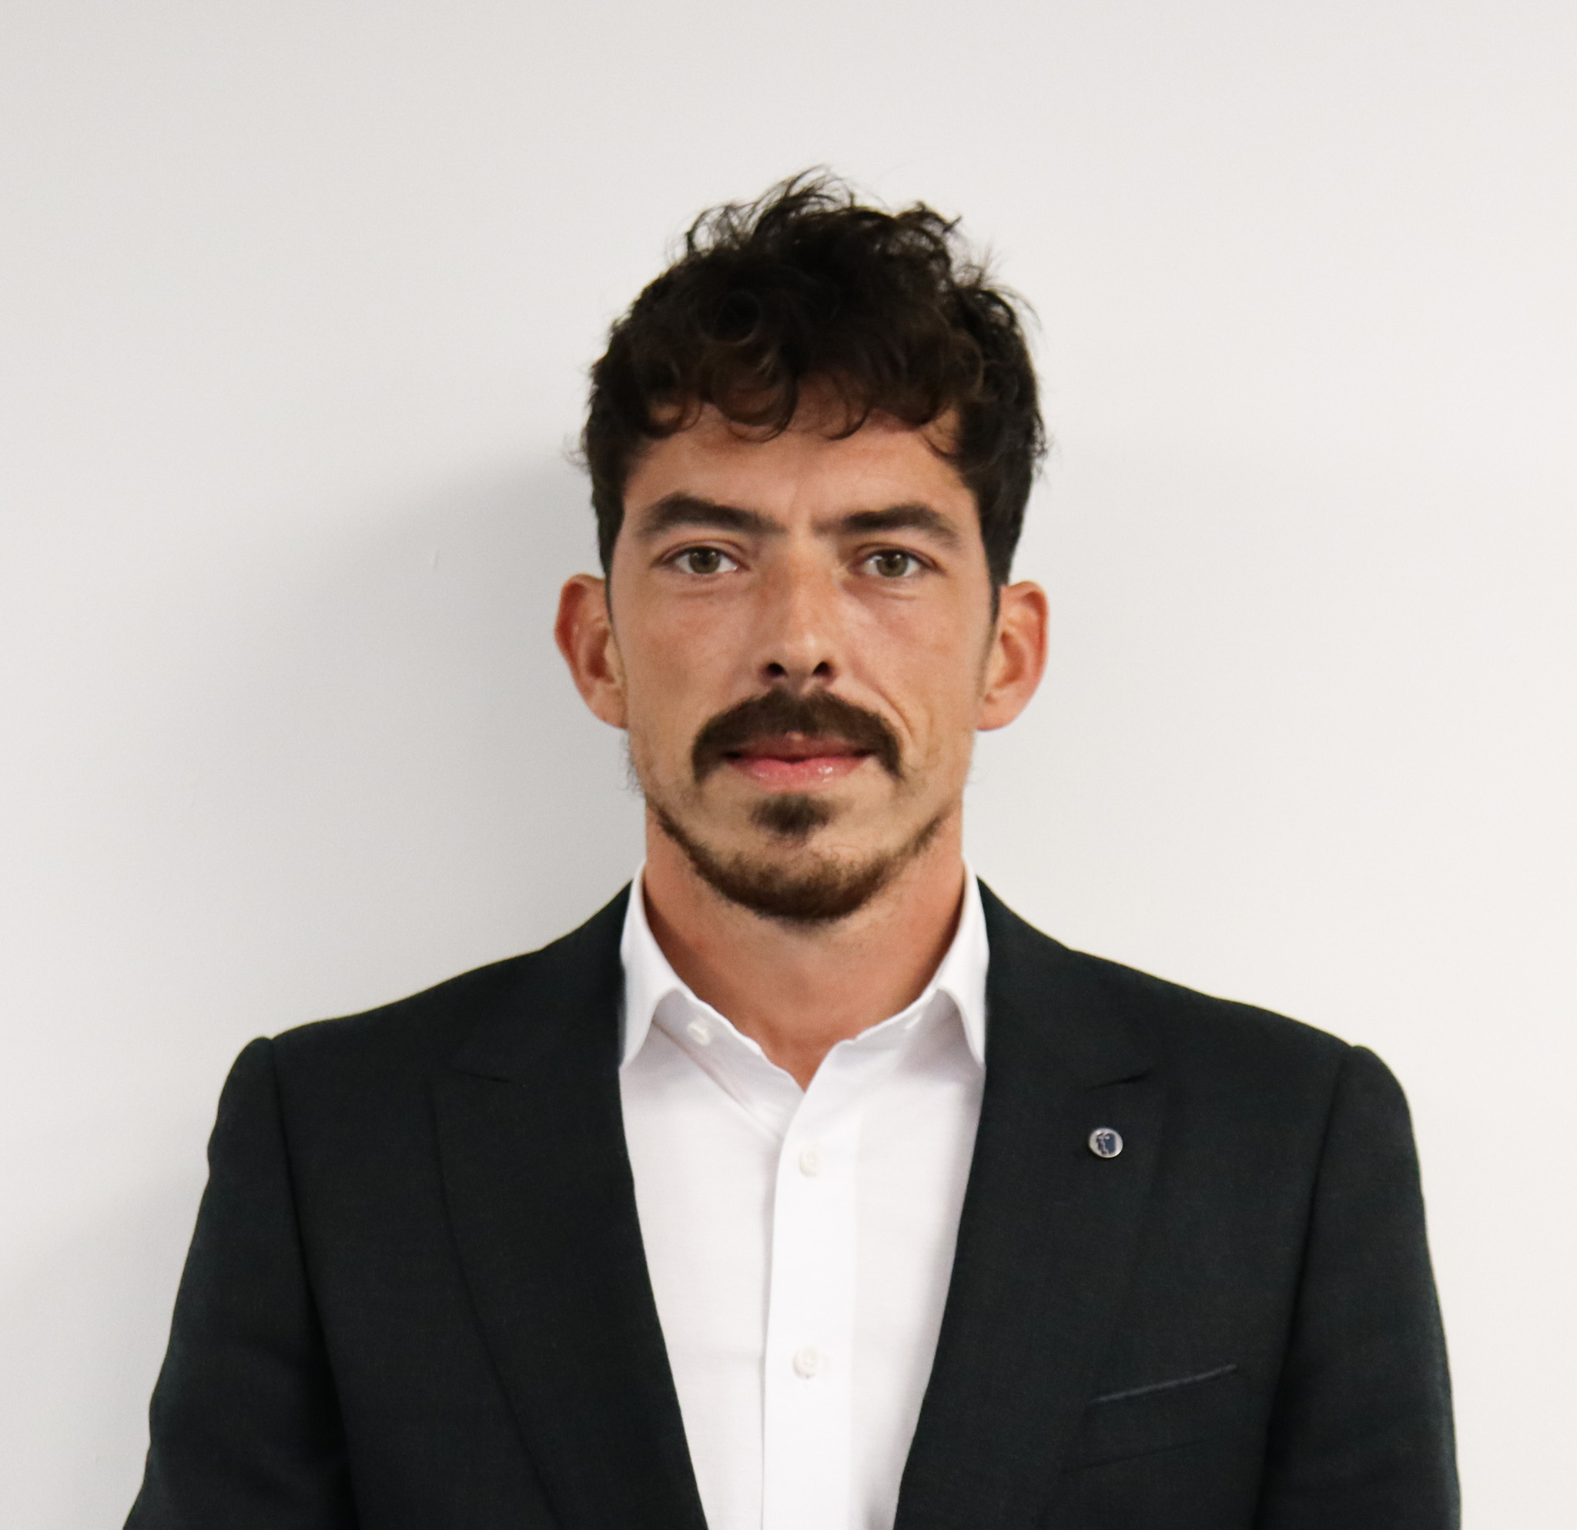
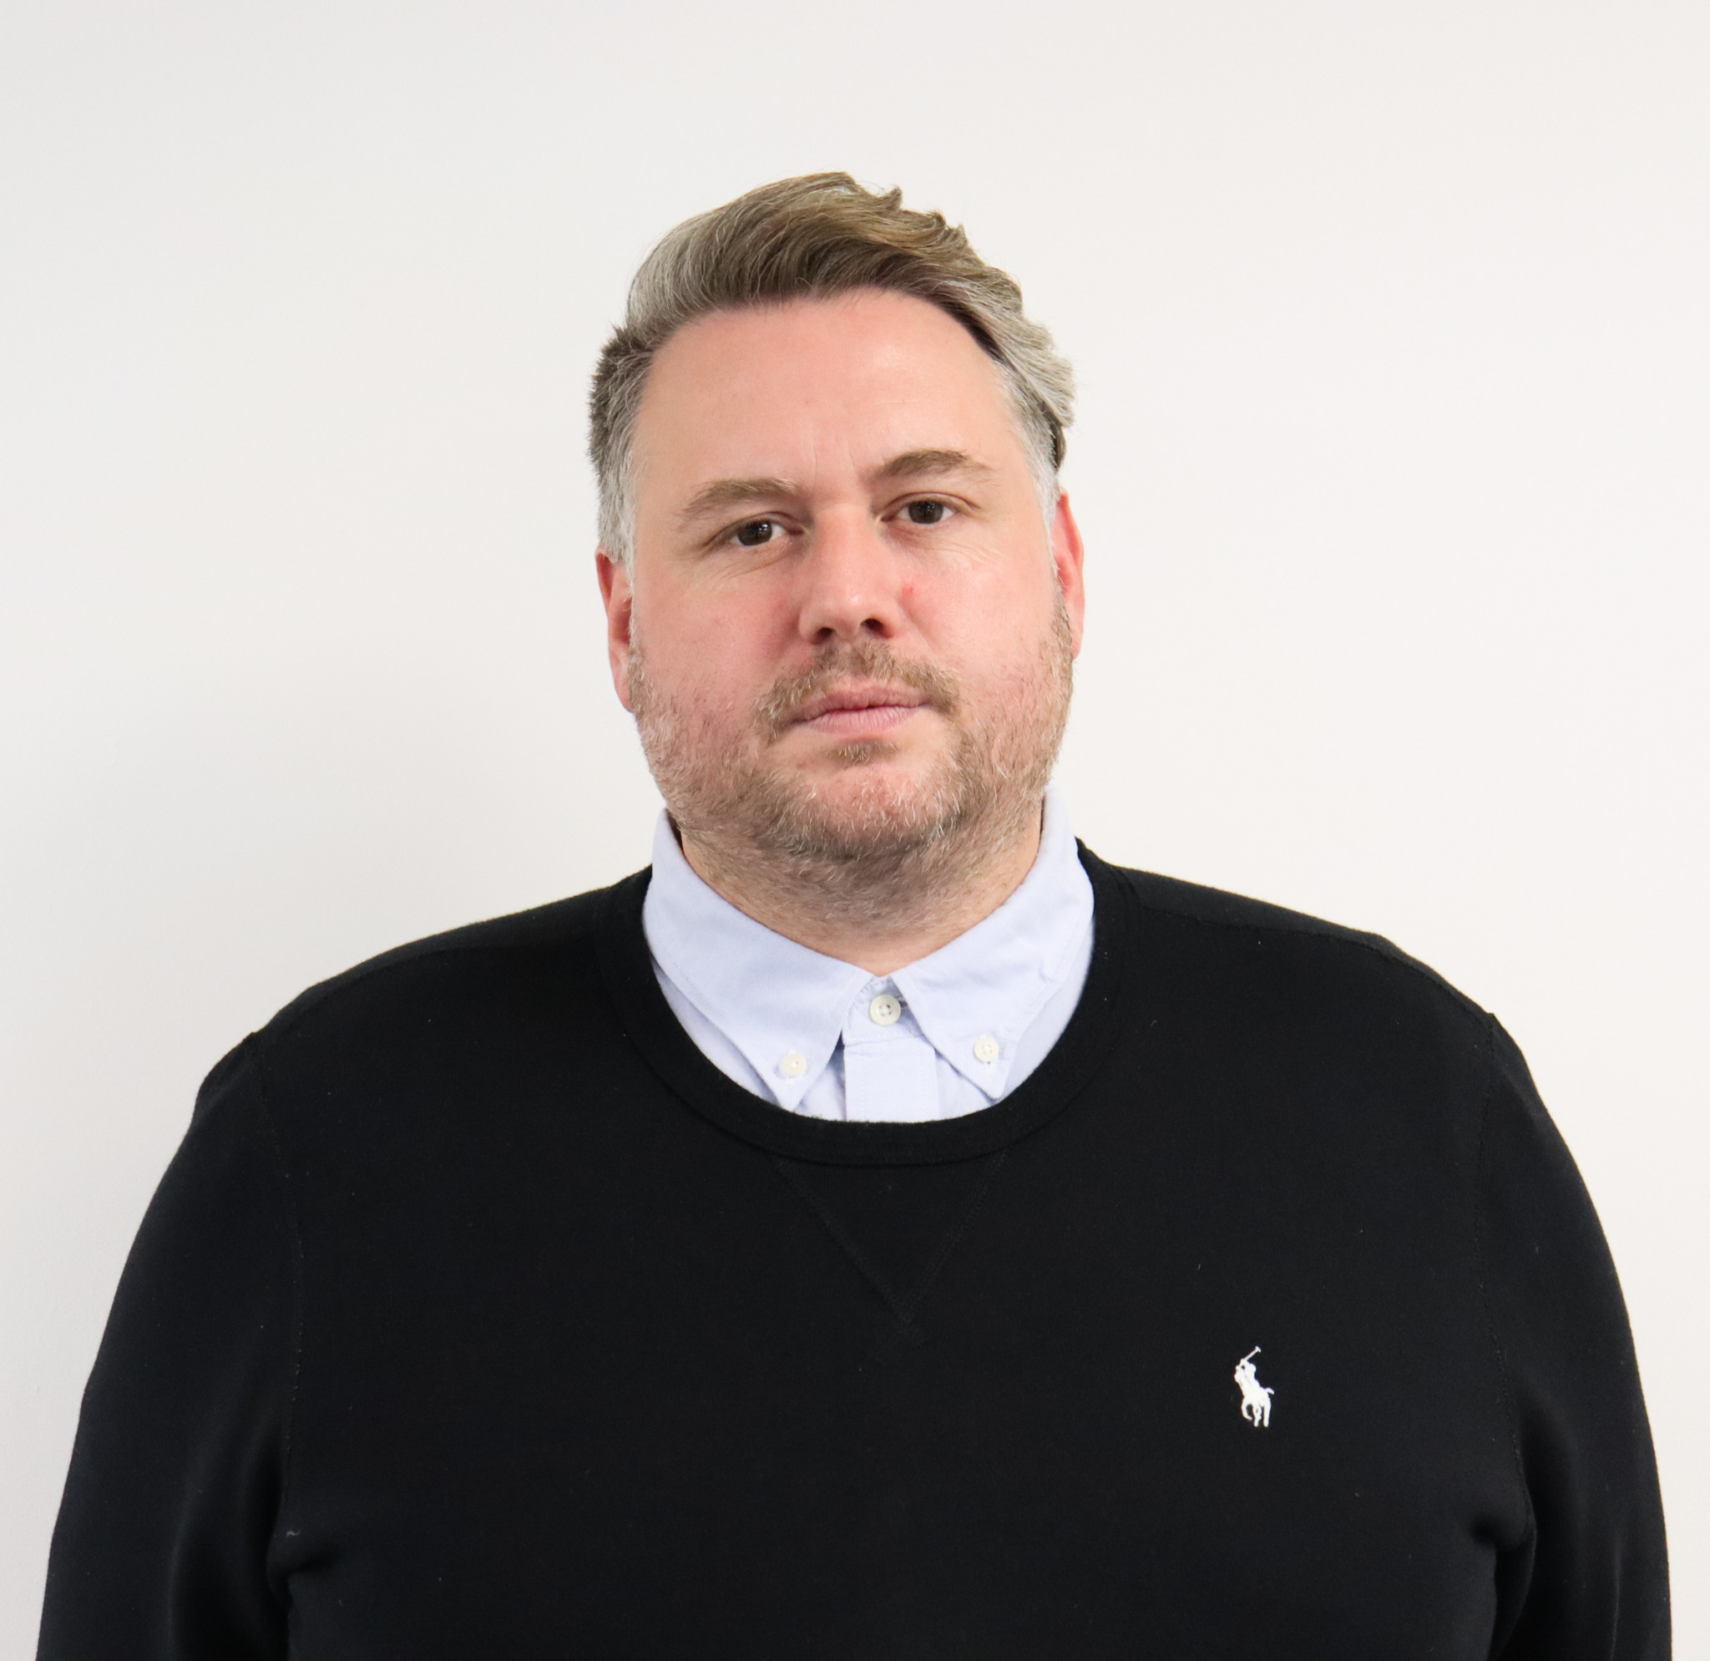
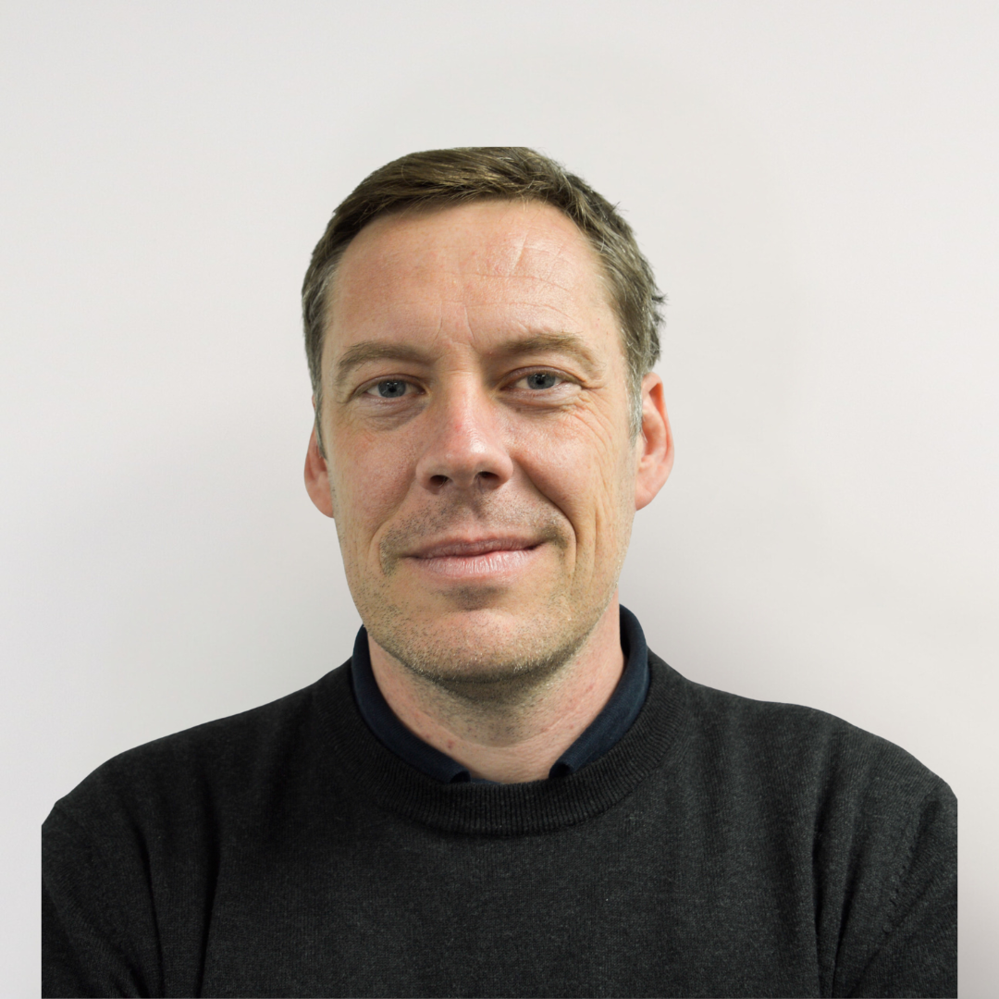
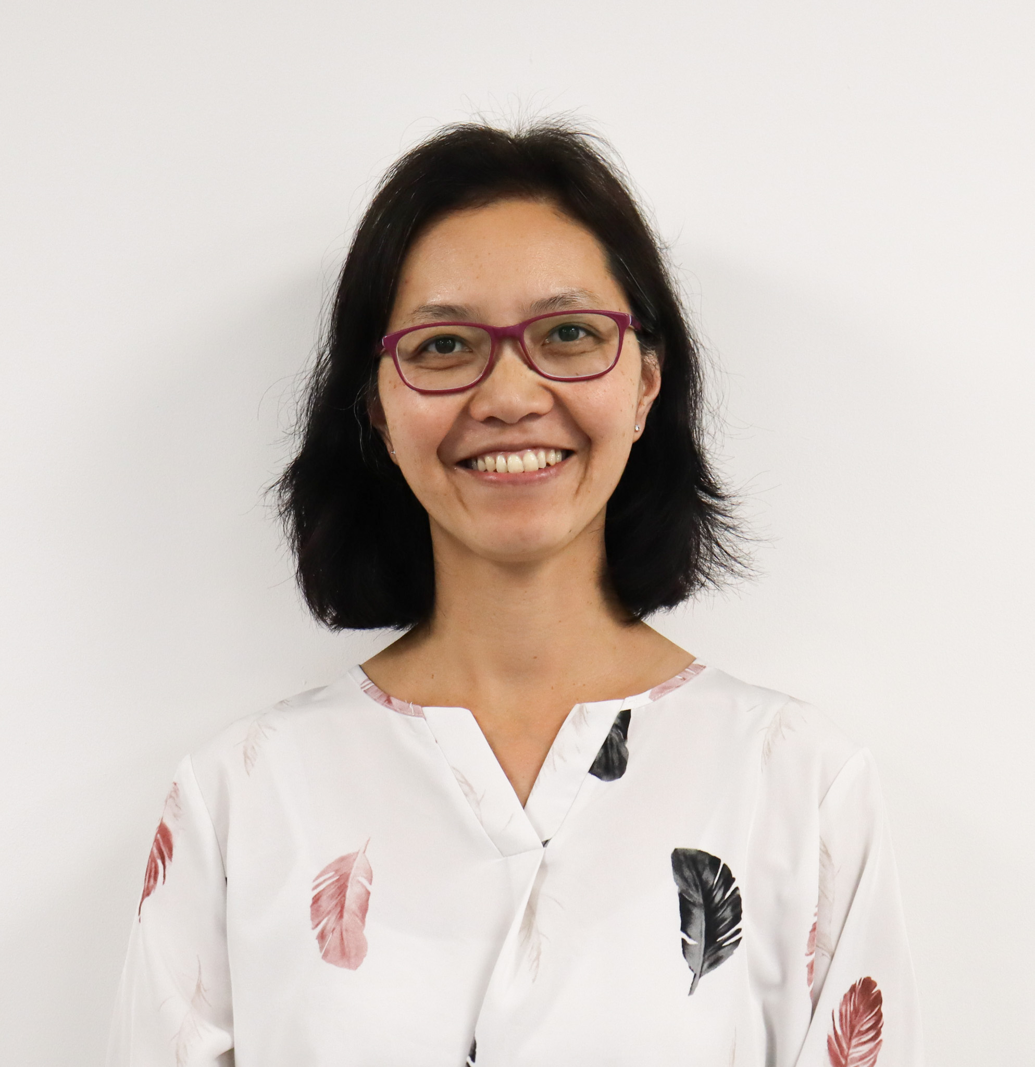
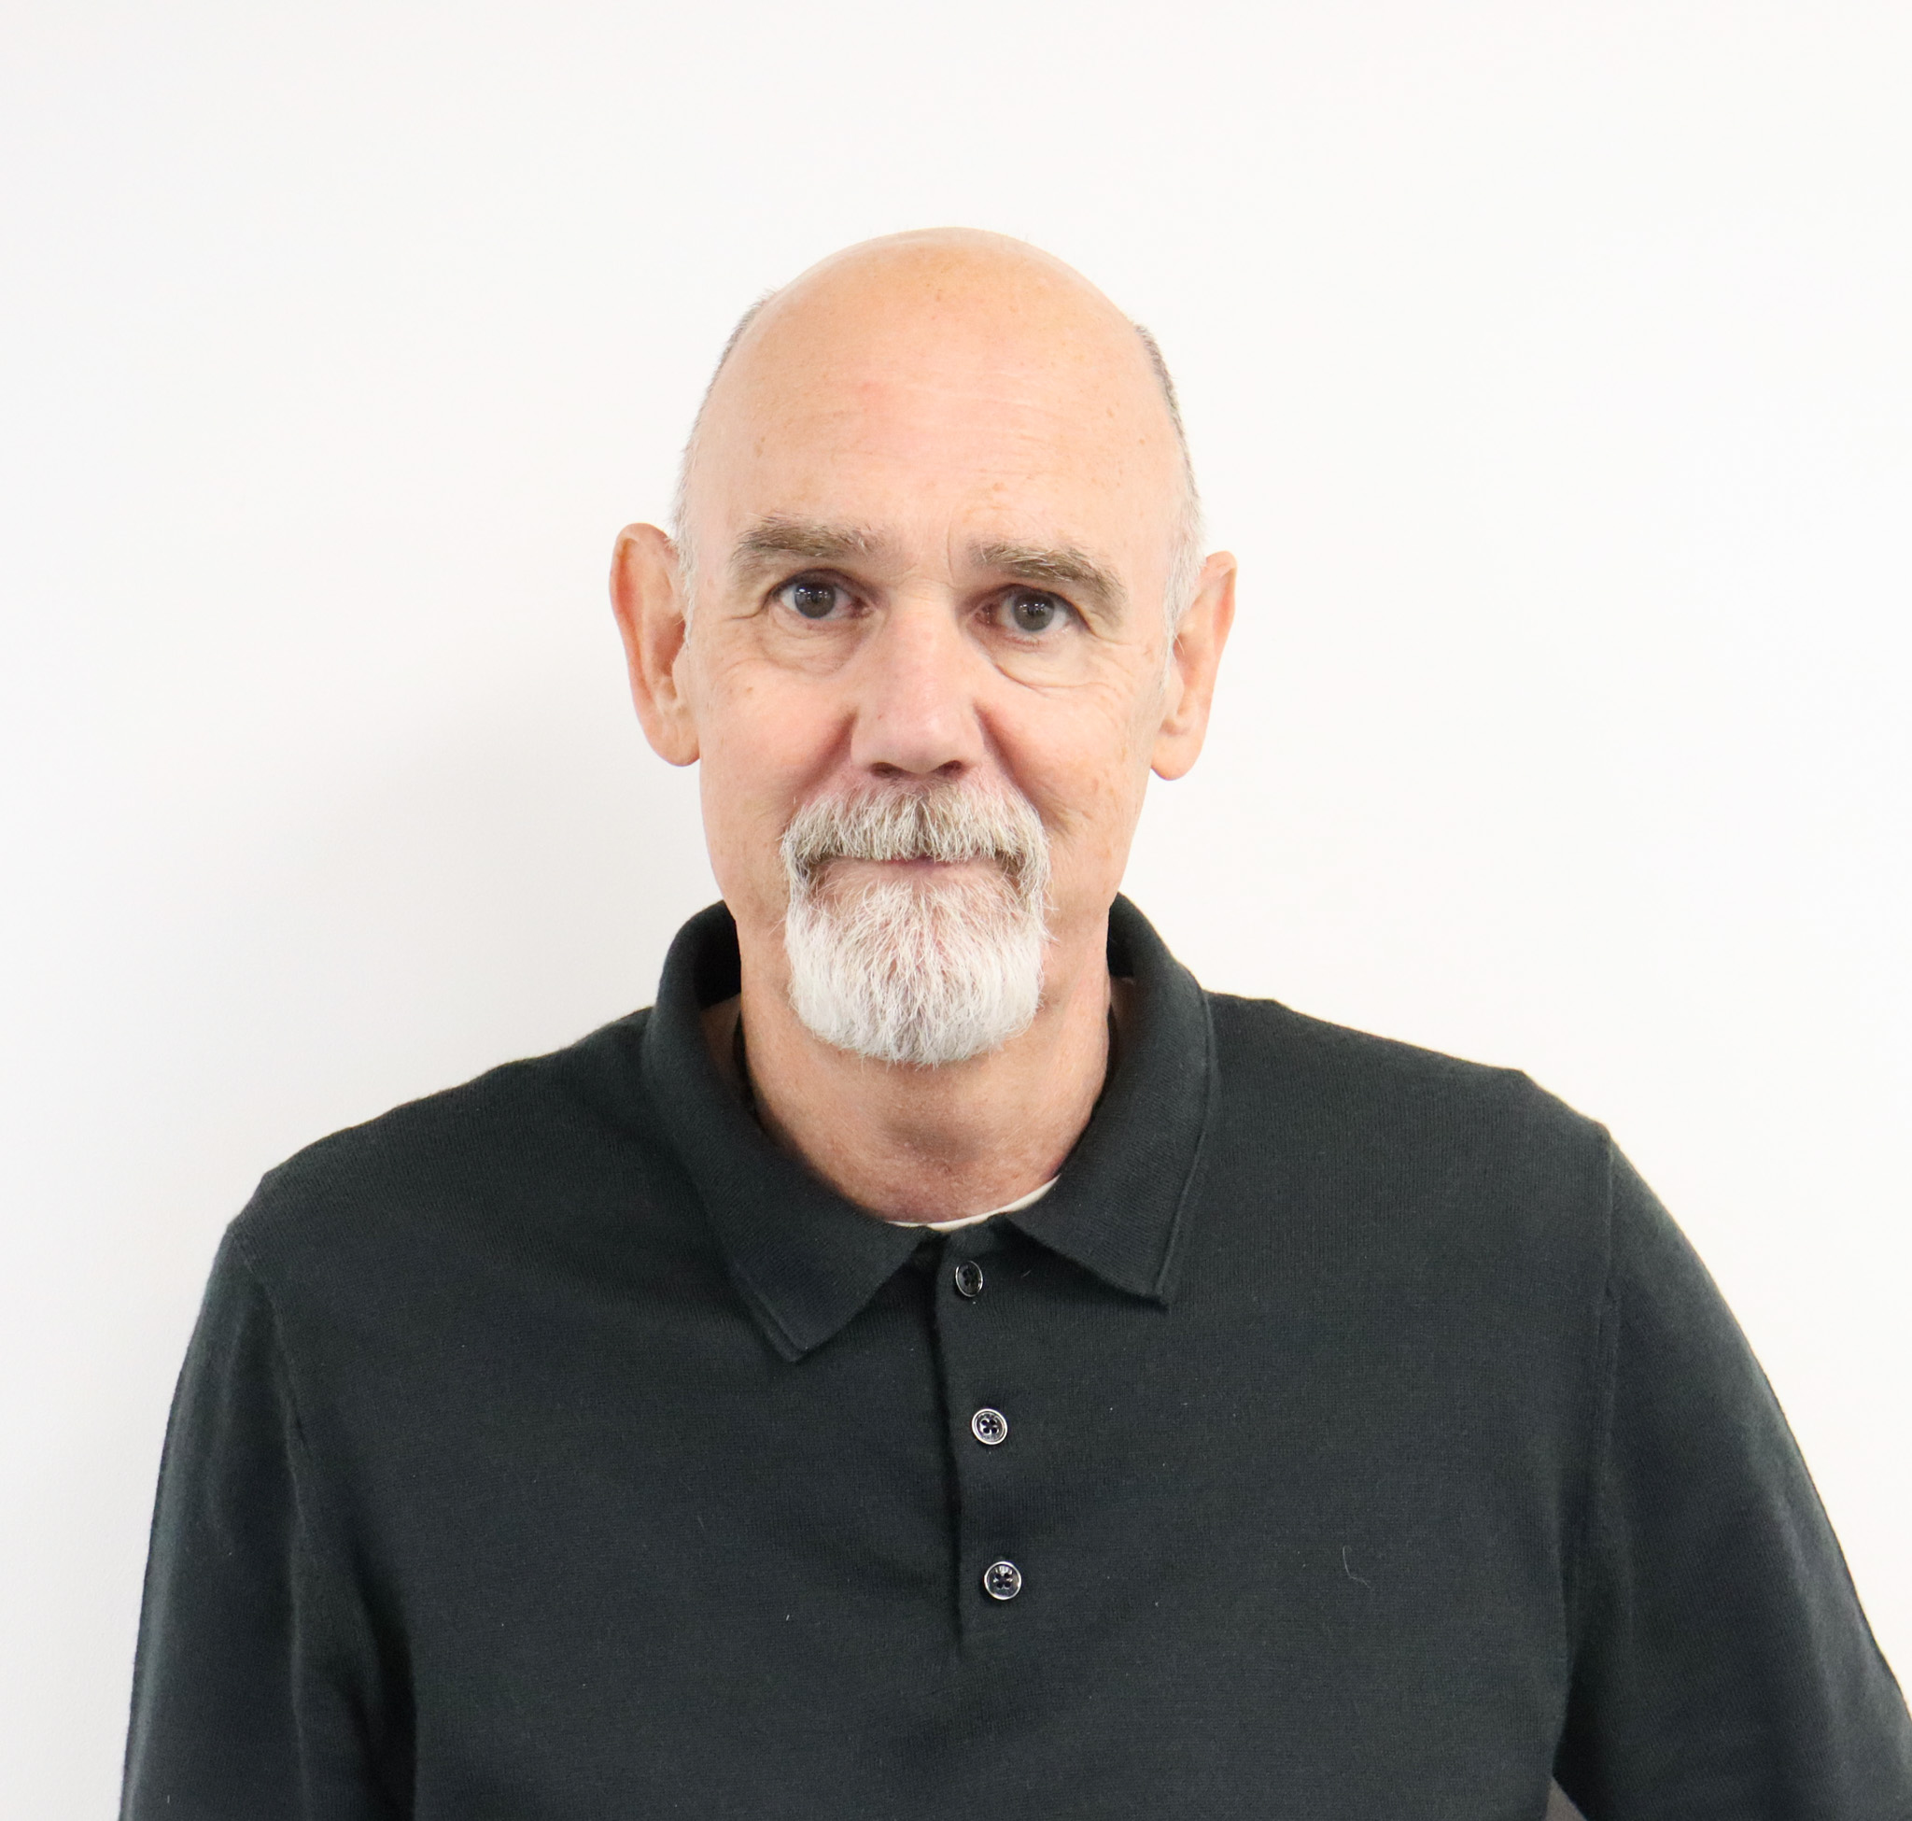

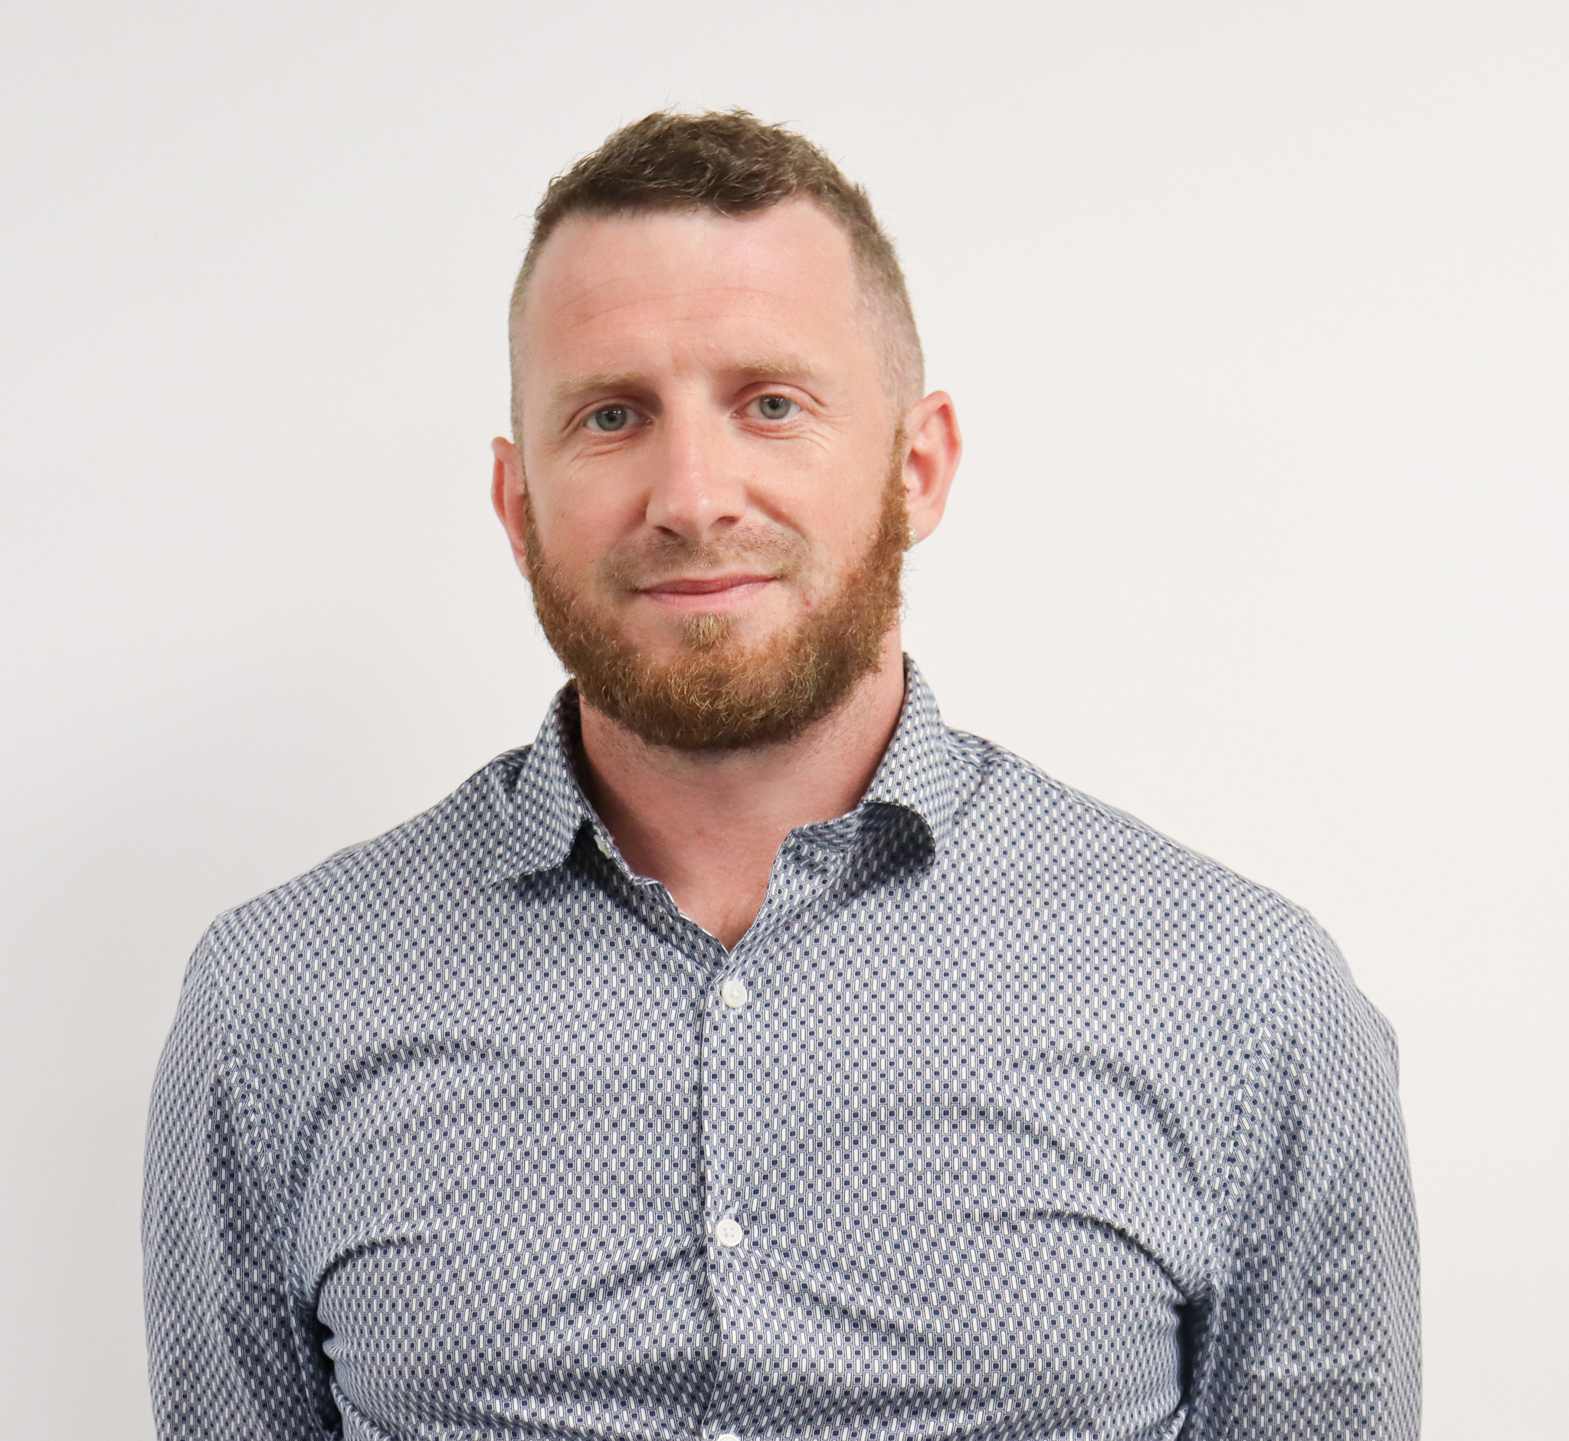
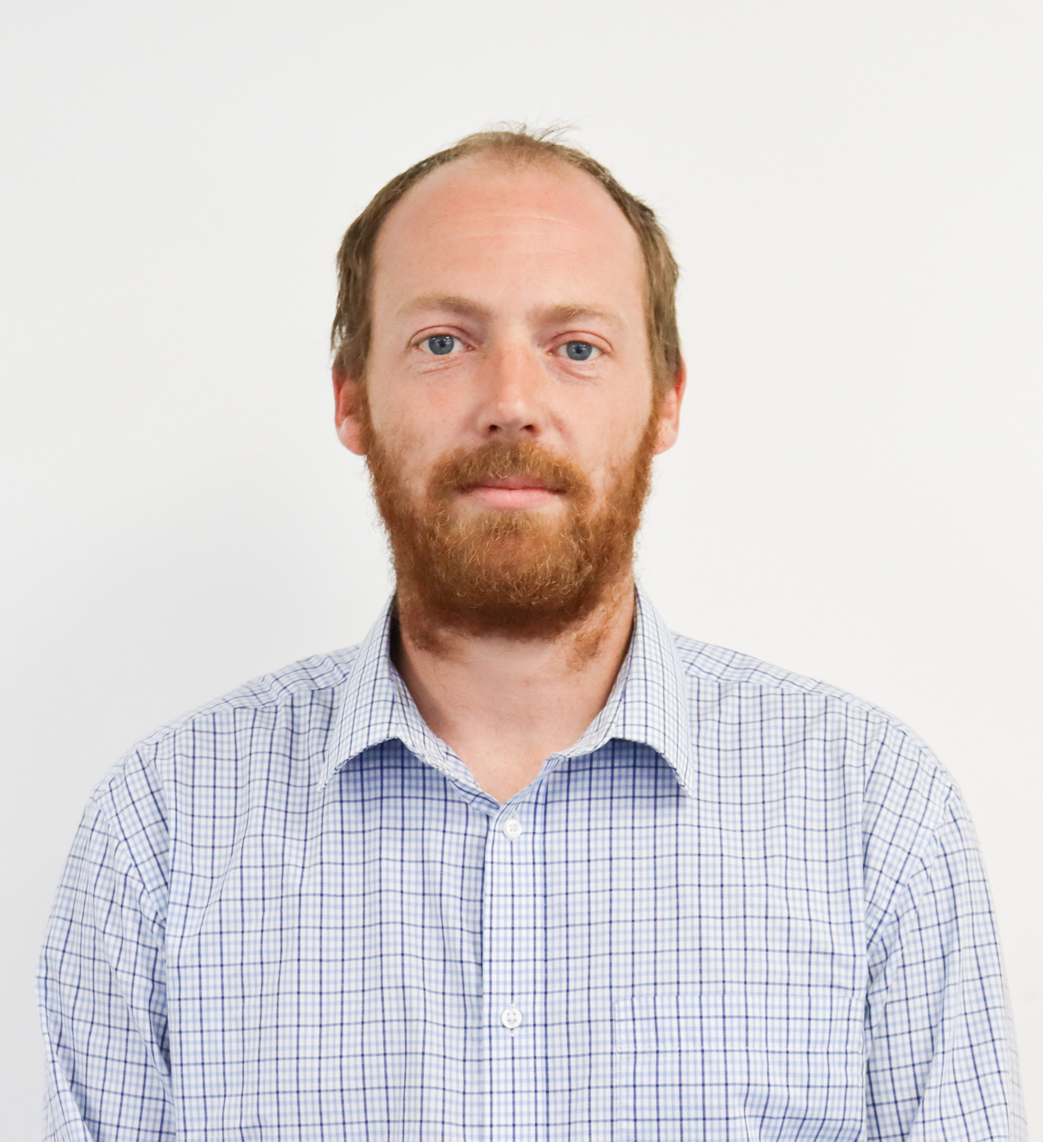
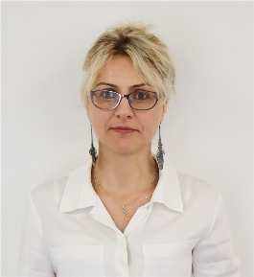
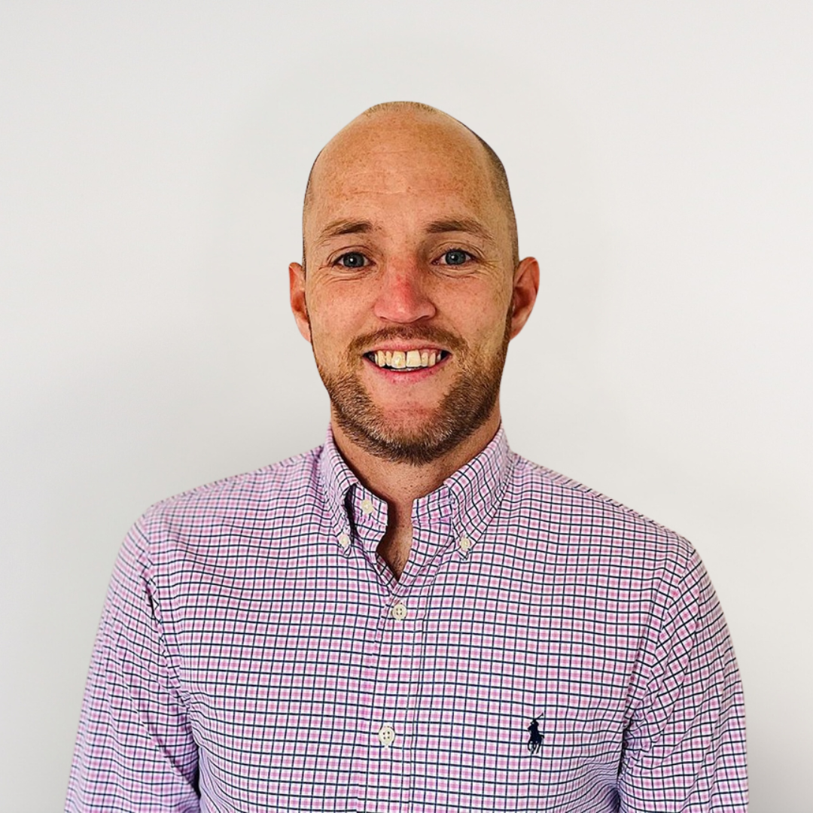
Our Leadership & Management Team
Ivan Patten
Managing Director
Ned Patten Director
Oliver Patten Director
CY Fagan
Finance Director
Simon Elkington
Contracting Manager
Olivia Lovley Service & Maintenance Manager
Joe Slee
MEP Operations Manager
Aston Baker Technical Manager
Nadya Dyson
HR Manager
Jamie Lewis
Commercial Business Manager & ESG Lead

Slide 6
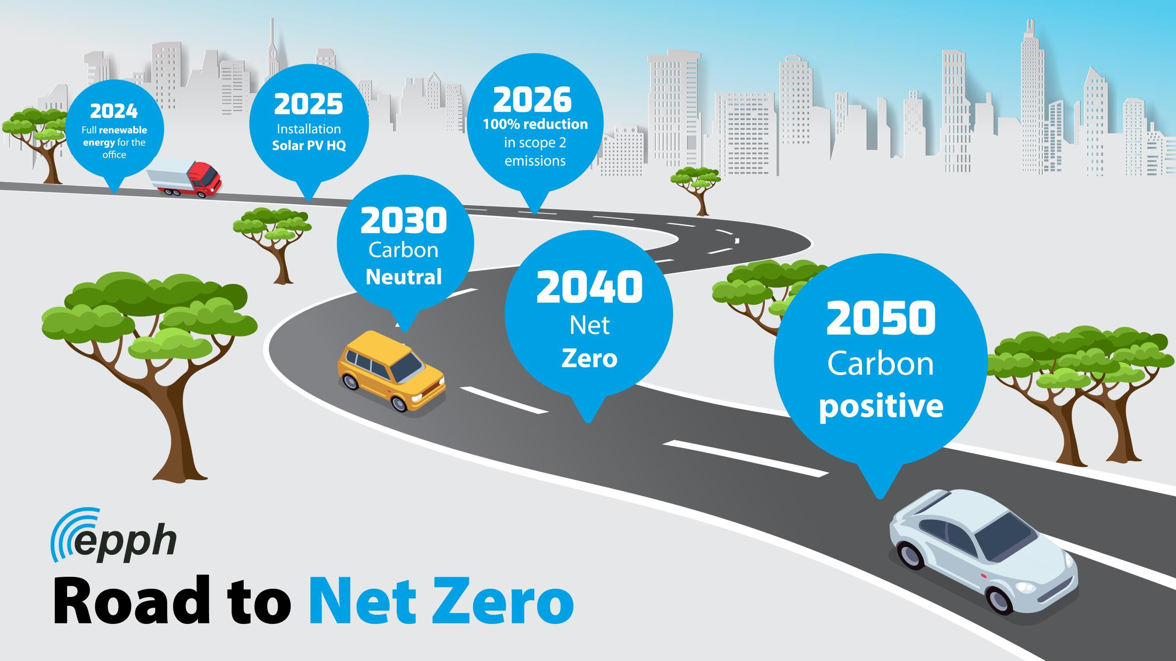

Slide 7

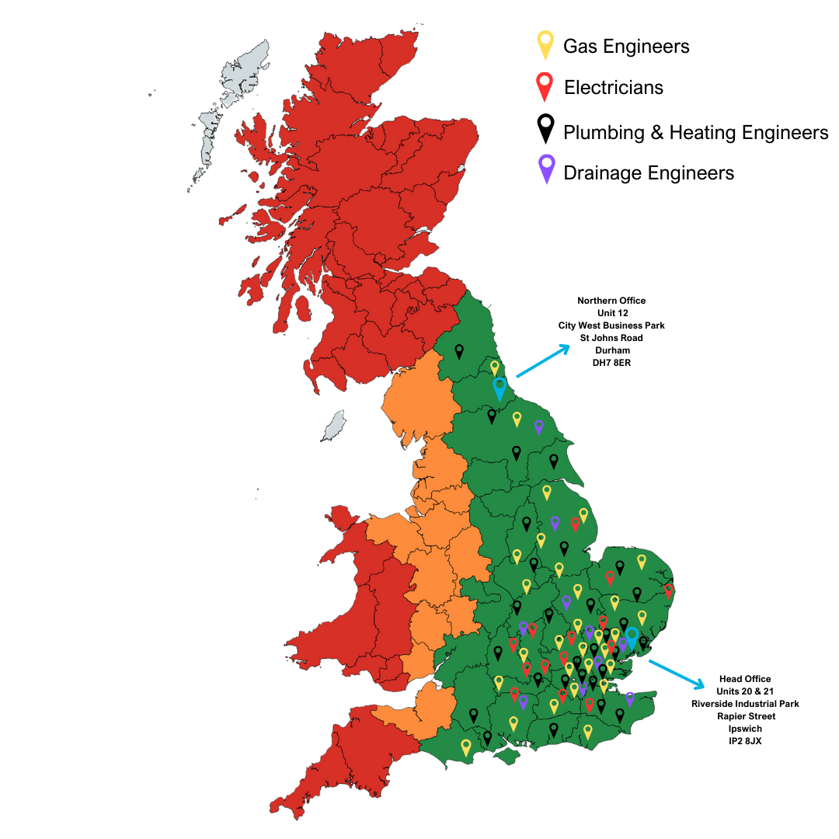
UK coverage
We can cover all the United Kingdom for planned works. As we are in a period of growth, we are recruiting additional staff, and coverage will naturally increase based upon demand and secured works.
Our core team currently cover all areas highlighted green for PPM, reactive, 24/7 call out and projects.
Locations highlighted in orange are covered for reactive and planned works only as we cannot commit to rapid response times.
Areas in red are only covered for high value, planned project works.
At EPPH, We pride ourselves on self-delivery with most of our works being delivered in house. Contractors that we do use, have been thoroughly checked at on-boarding stage for competency, insurance, security clearance and we have built up partnerships over time to ensure quality is at the forefront of everything we do.

Slide 8


Who are we?
M&E contractor capable of delivering all aspects and PPM, Reactive and project works.
In house design team with capacity to undertake design and build projects.
Renewables specialist with extensive heat pump, solar and LED installation experience.
Sustainability audits undertaken which offer guaranteed, insurance backed savings.
Competitive PPM contracts with agreed SLA’S, rebates and reduced rates can be agreed
24/7 cover 365 days a year with security cleared staff
In house drainage division.
Outstanding health and safety record.
Notes:
Delete bullet points as appropriate

Slide 9
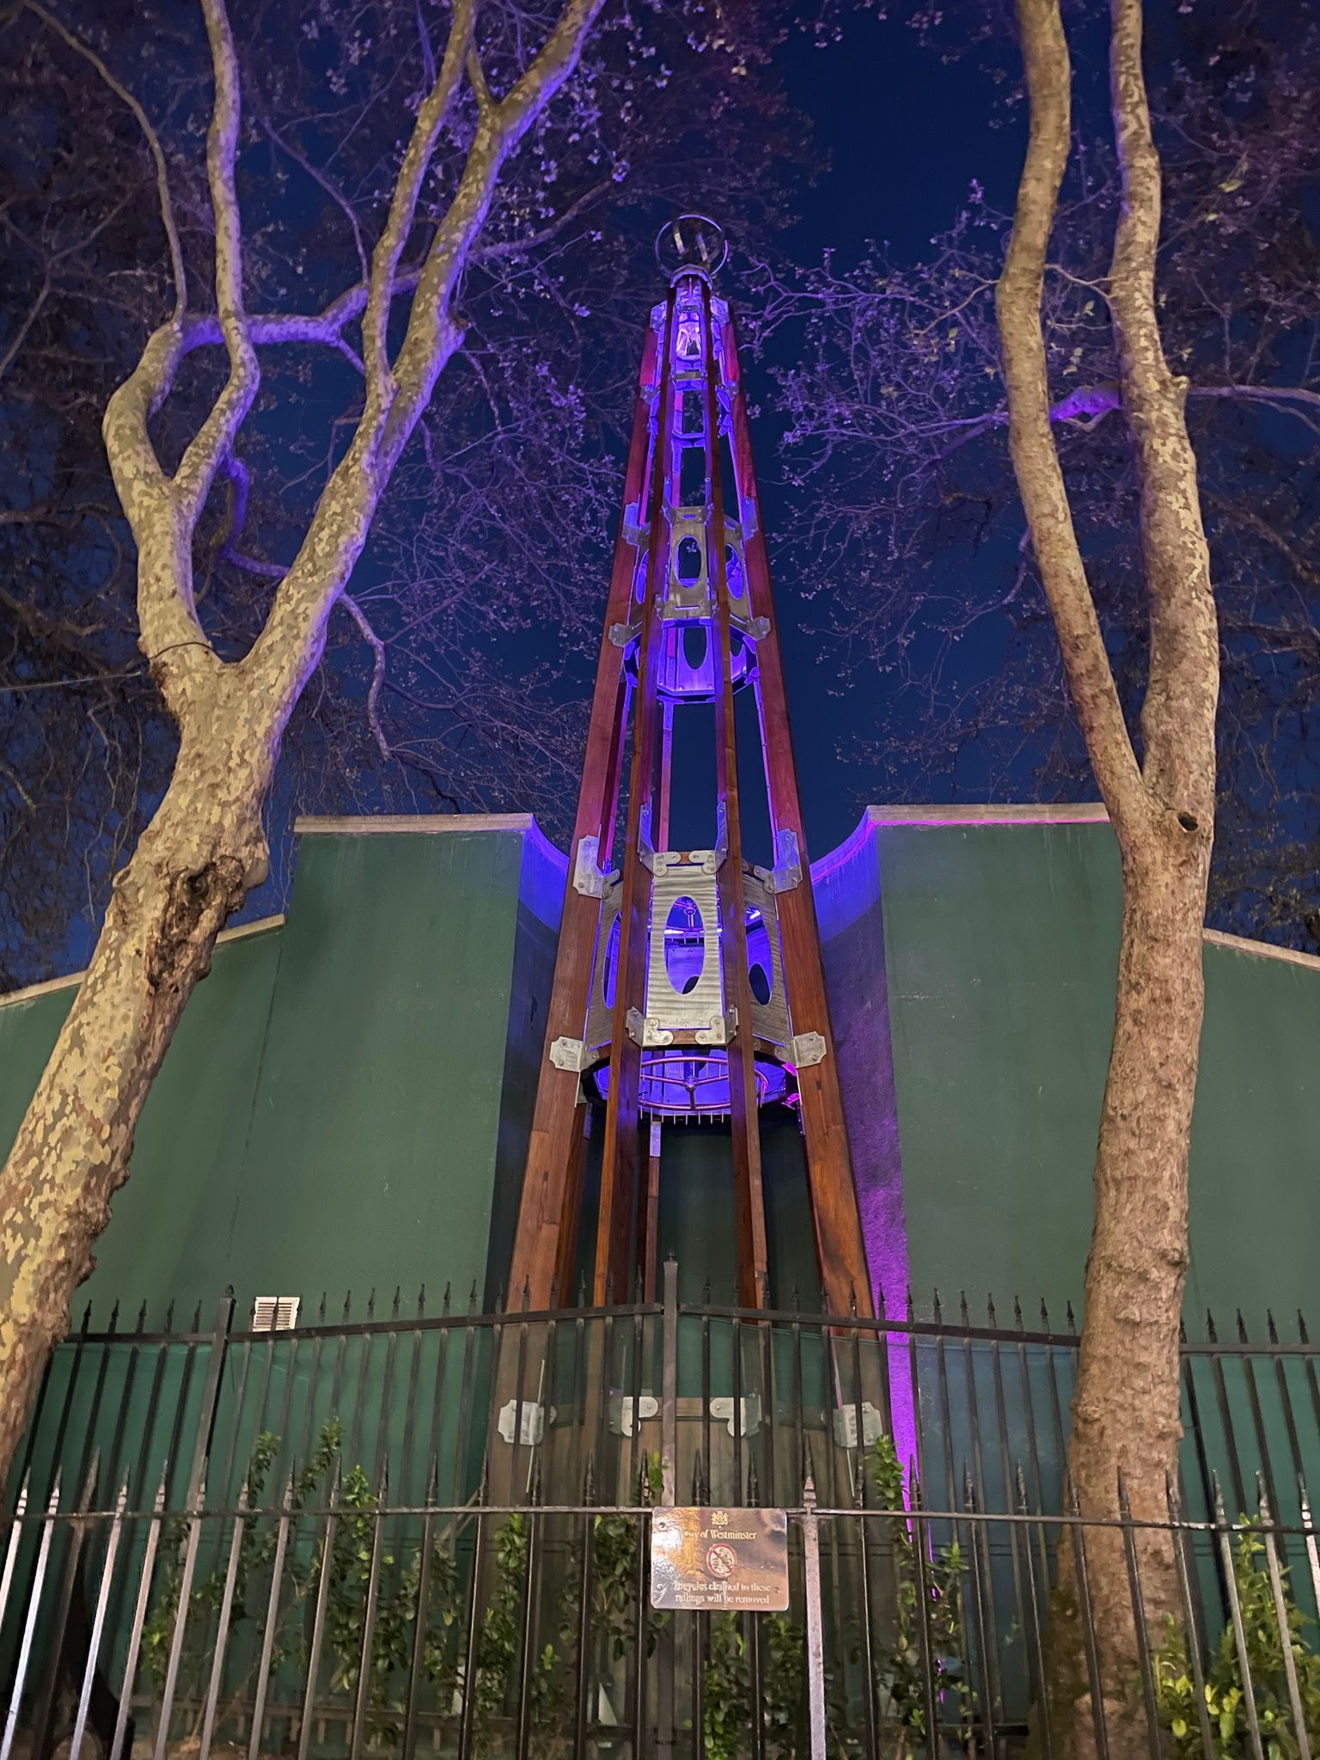
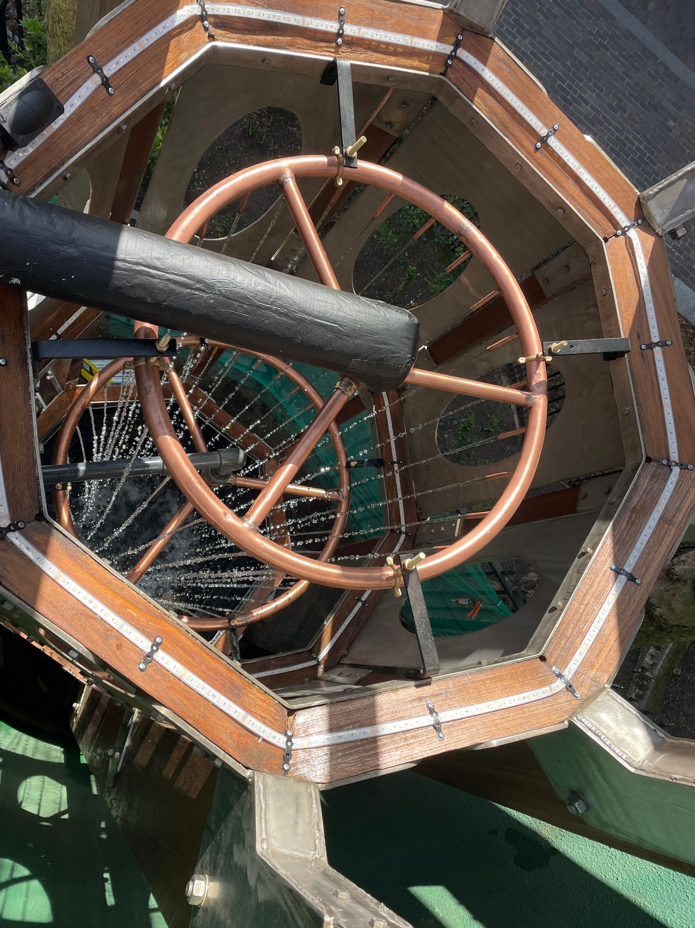
Drainage Division – Case Study
Project – Embankment Water Fountain
Client – CBRE
Value – £65,000
Scope – This project marks the successful restoration of a historic water tower, delivered in collaboration with CBRE. Over the course of the project, our team carefully revitalised the structure while preserving its original character. Works included detailed timber restoration, structural refinishing, and key modern upgrades to improve both longevity and visual impact.
This restoration not only preserved an important heritage structure but also enhanced its durability and nighttime presence. The architectural lighting serves as a standout feature, highlighting the craftsmanship involved. The project was delivered to a high standard with outstanding client feedback.

Slide 10
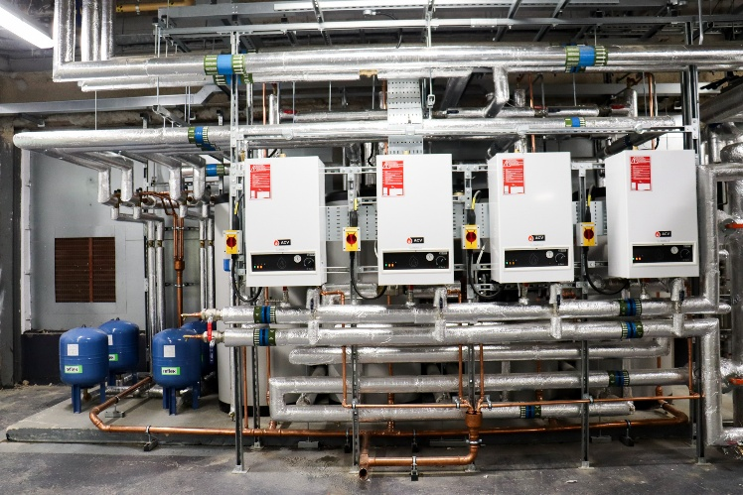
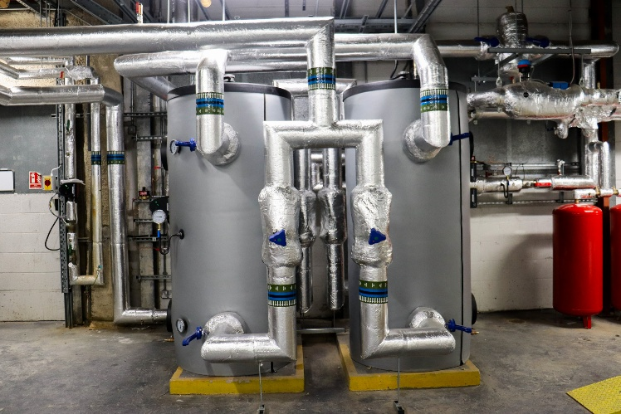
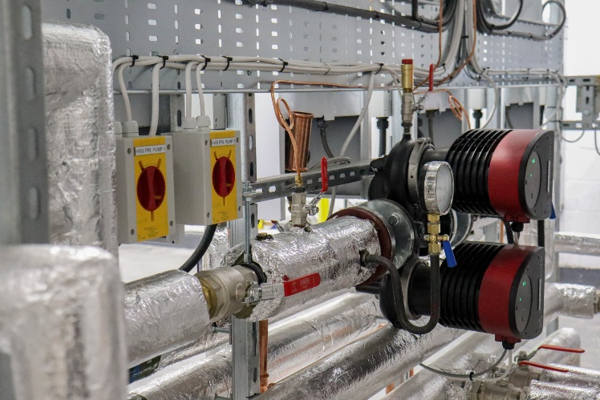
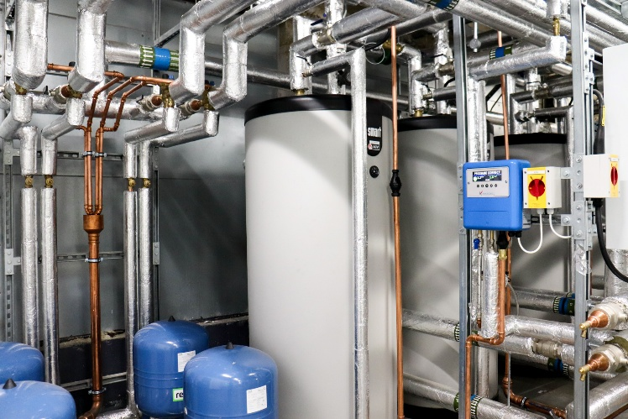
Projects Division – Case Study
Project – 10 South Colonnade
Client – Government Property Association
Value – £undisclosed
Scope – The project consisted of decommissioning 2 x gas boilers and 4 indirect hot water heaters and replacing with ASHPs, calorifiers and booster sets all plugged into a brand new BMS panel integrated across the building, the was final piece in fully decarbonising the full building (the first in the whole government estate)
EPPH carried out the installation and commissioning of the below -
Full design
BMS Panel (includes integration)
4No ASHP
4No Indirect calorifiers
Booster Sets
New DHW pumps
New ACV Water Heaters

Slide 11
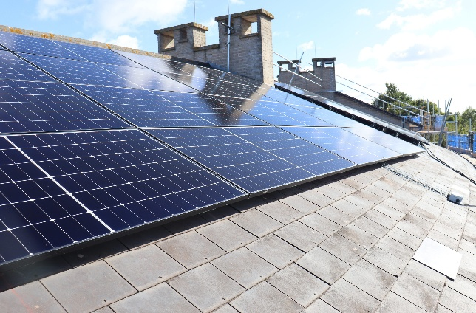
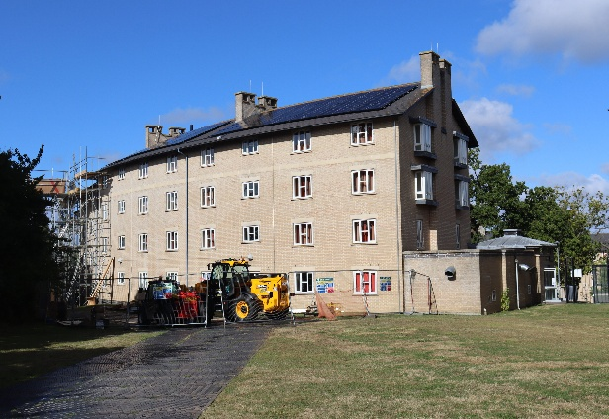
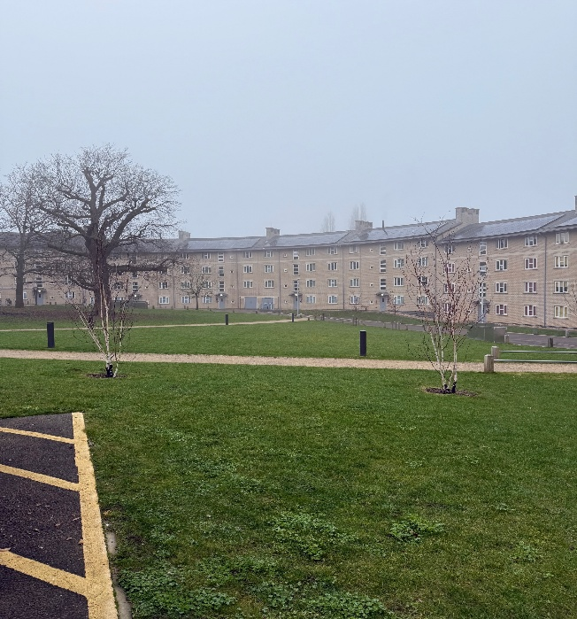
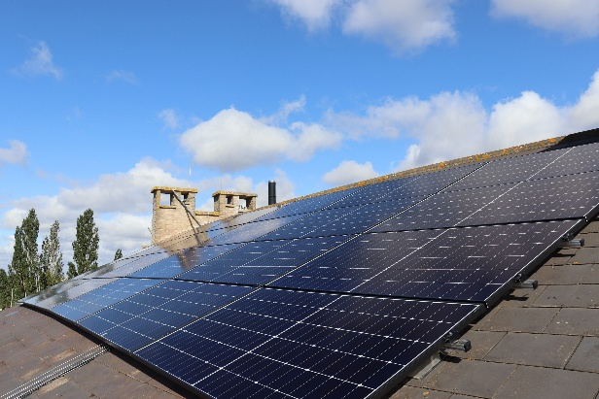
Projects Division – Case Study
Project – Essex University, South Courts
Client – University of Essex
Value – £1,300,000 +
Scope – This extensive solar photovoltaic (PV) installation project involved the comprehensive design, supply, and installation of nearly 800 kilowatts peak (kWp) of solar panels. The scope of work encompassed all necessary components, including inverters, bird protection measures, electrical cabling, and bespoke export limitation devices.
Key Deliverables
Solar Panel Installation: Installation of over 1,500 solar panels across eight separate building areas.
Bird Protection: Implementation of bird proofing measures on all solar arrays to safeguard both the birds and the equipment.
Inverter Installation: Installation of nine inverters, ranging in size from 30 kW to 100 kW, to convert DC power from the solar panels into AC power for the grid.
Electrical Cabling: Installation of over 5.5km of DC cable to connect the solar panels to the inverters.
Export Limitation Devices: Installation of bespoke export limitation panels to manage the flow of electricity to the grid.

Slide 12
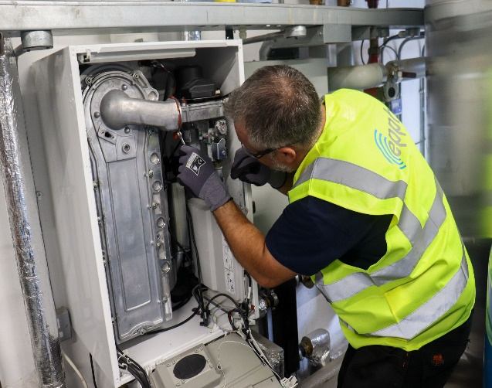
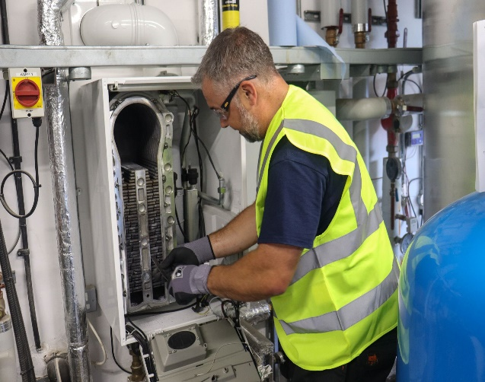
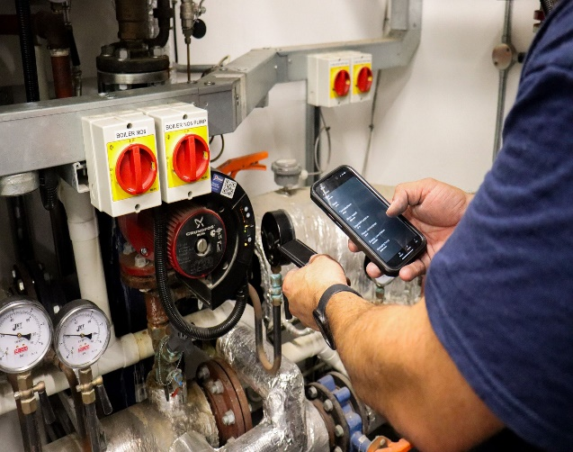
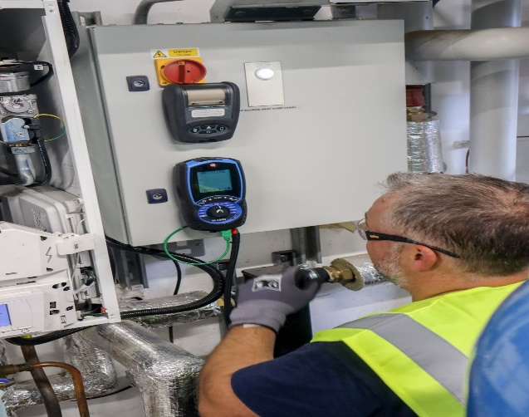
FM Division – Case Study
Project – Undisclosed/ various MOJ sites
Client – Ministry of Justice
Value – £108,000 Per Annum Service Spend
Scope – On Behalf of the MOJ, EPPH are employed to undertake the following scope of PPM works across 135 sites Nationally.
These include items such as Gas boiler and pipeline testing & servicing ranging from 20kW to 2mW plant. All of which include full strip downs, service kits and health check reports.
We also cater to HVAC PPMs such as AHUs, Chilled water systems, DHW, Solar PV, Air Source Heat Pumps, drainage and much more.
We offer a bespoke CAFM system that captures each asset maintained and allows client reporting across all sites and assets to ensure compliance and pipeline spends.

Slide 13
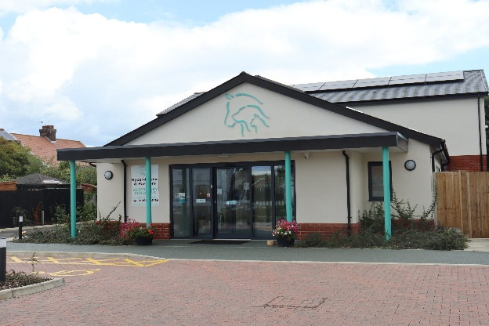
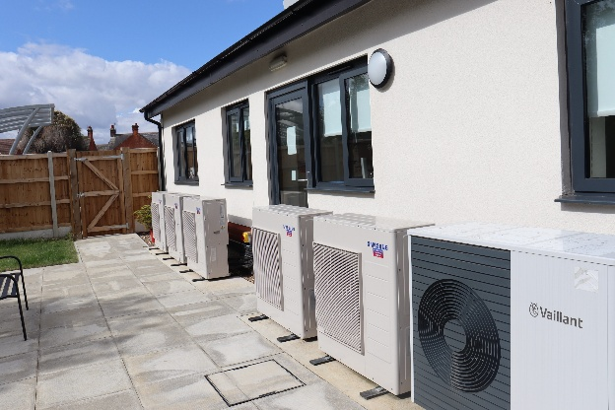
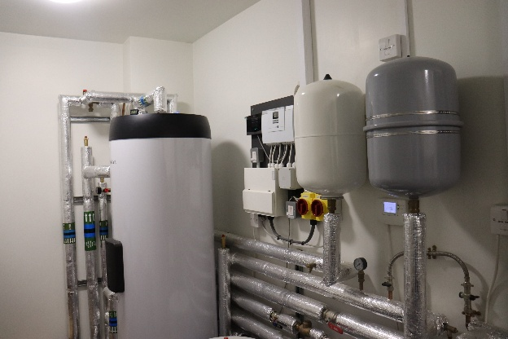
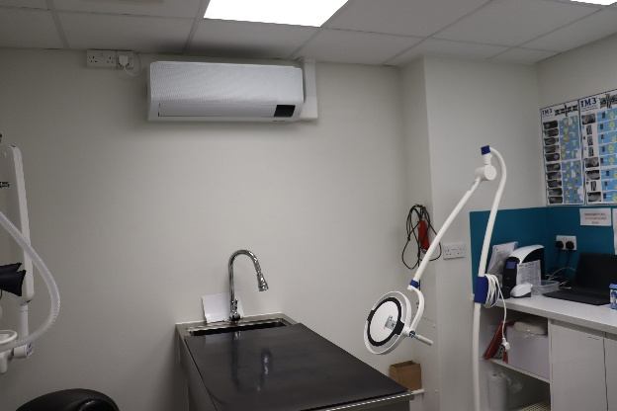
Contracting Division – Case Study
Project – Felixstowe Vet’s Surgery
Client – Seamans Building
Value – £200,000 +
Scope – This new build project successfully delivered a comprehensive mechanical installation, providing efficient and comfortable heating, cooling, ventilation, and hot water services to the building. The installation of energy-efficient equipment, such as the air-source heat pump and MVHR system, contributed to the overall sustainability of the project. The timely and budget-conscious delivery of the project demonstrates EPPH’s expertise in mechanical installations and commitment to customer satisfaction.

Slide 14

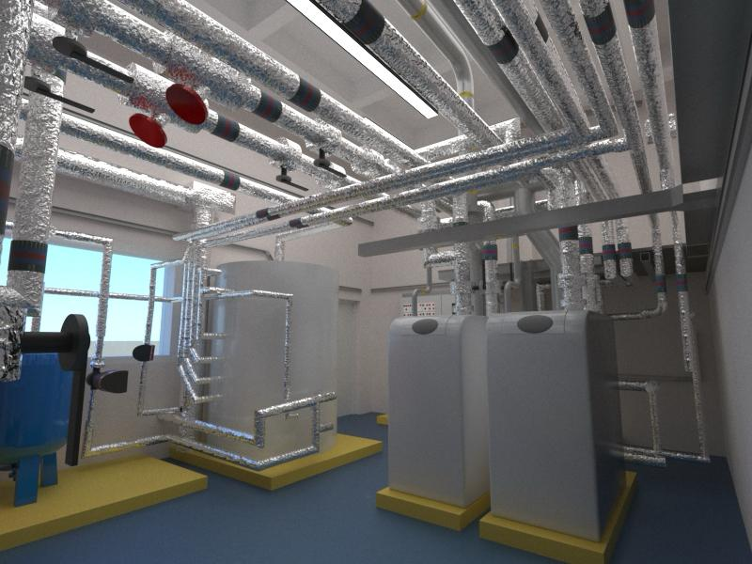
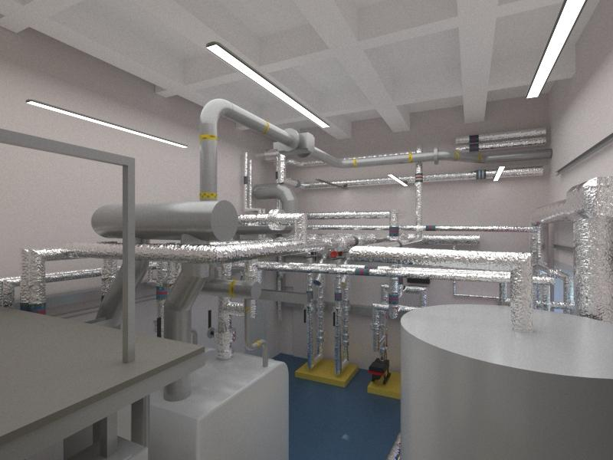
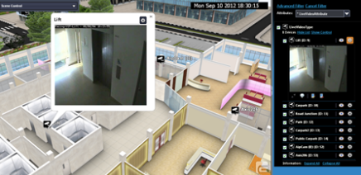
3D imaging technology added to the BMS
EPPH believe that this is where the future lies when operating large commercial premises efficiently. Having the ability to capture faults as they occur, intrusively investigate plant remotely, capture any required parts and send an engineer with the correct skillset to the job with materials maximises efficiency , reduces cost and downtime.
Additional data captured by the BMS reduces the need for on-site ppm attendance as we can evidence condition remotely.
This technology can be added to existing BMS or included within the design of new installations.

Slide 15
Sustainability Survey’s
We propose to survey and assess estates to capture buildings with the highest energy consumption utilizing meter readings and related bills. We then attend site to undertake a technical survey to capture areas where improvements can be made then complete initial feasibility surveys.
Upon completion of the surveys, we issue proposals detailing indicative costs for outlay, proposed annual savings and a payback term. These can be insurance backed to ensure proposed savings are achieved and each project is deemed a success.
We work closely with our partners to install state of the art technology which reduces maintenance costs, down time and captures faults live and energy consumptions via cloud-based portal.
The no win no fee proposal is on a site-by-site basis. We propose a solution which will include initial project works to improve the consumption usage. If our proposal does not achieve the proposed savings , the project cost would not be charged.
We recently saved one of our clients over £700,000 p.a in one commercial building alone. Significant savings are to be had with the right technologies and applications producing win-win outcomes with reduction in carbon and cost.

Slide 16
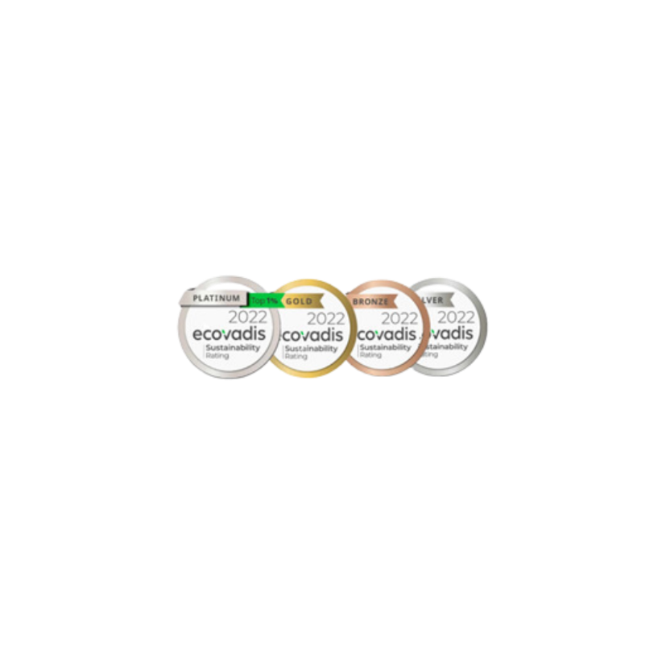



Environmental Social Governance
EPPH are a member of Ecovadis in line with CBRE’s expectations and conduct annual reporting as requested. Sustainability rate post questionnaire is pending.
EPPH has signed up for Emitwise and we are aiming for a score above 47 as per CBRE preferred supplier guidelines.
EPPH proudly holds Suffolk Carbon Charter Bronze Status for our ongoing commitments to reducing our emissions across all scopes and striving for net zero in operation by 2040.
EPPH support many apprentices' year after year and are members of the 5% club. In being a member, we achieving at least 5% of our workforce in earn and learn positions (including apprentices, sponsored students and graduates on formalised training schemes). During 2022/23 we averaged 16%.

Slide 17

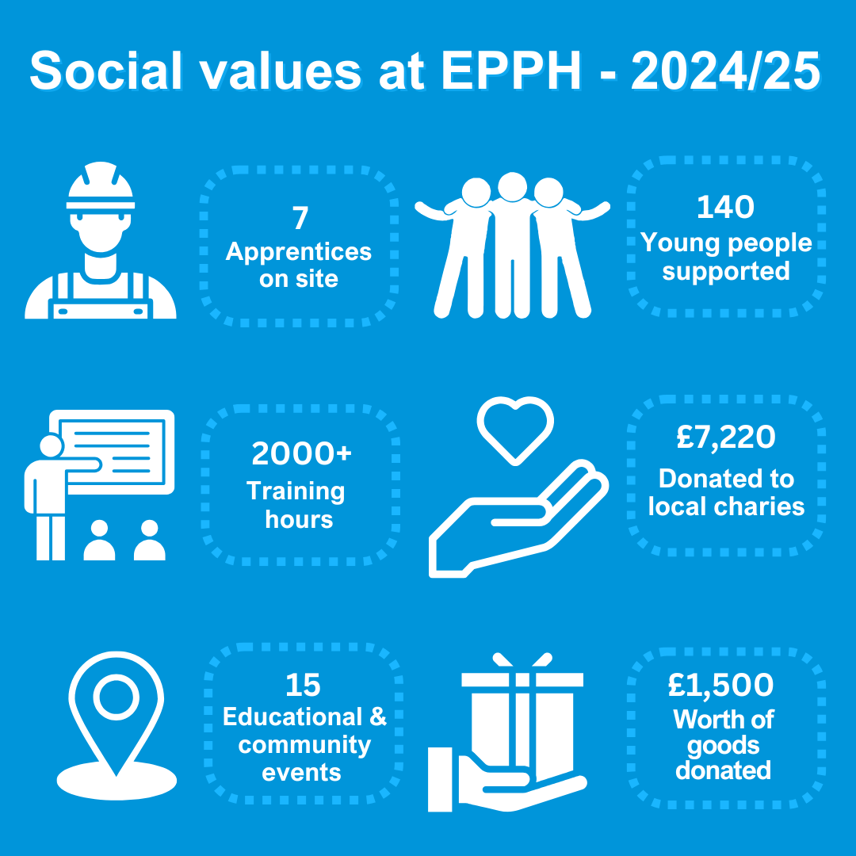
Social Value Delivered in 2024
During 2024 we supported a total of 7 apprentices across our mechanical and electrical divisions.
During 2024 we supported multiple careers days and events helping young people improve their interview skills and prepare for the world of work.
During 2024 we helped deliver over 2000 training hours across multiple locations and platforms including DSEAR Awareness Training.
During 2024 we donated to multiple charities including our two charities of the year – Suffolk Mind East Anglia's children's hospice (EACH)
During 2024 we proudly attended 15 educational and community events. We attended events such as career fairs to client events
During 2024 we donated goods to various charities and schools. This includes Suffolk New College and Lofty Heights.

Slide 18
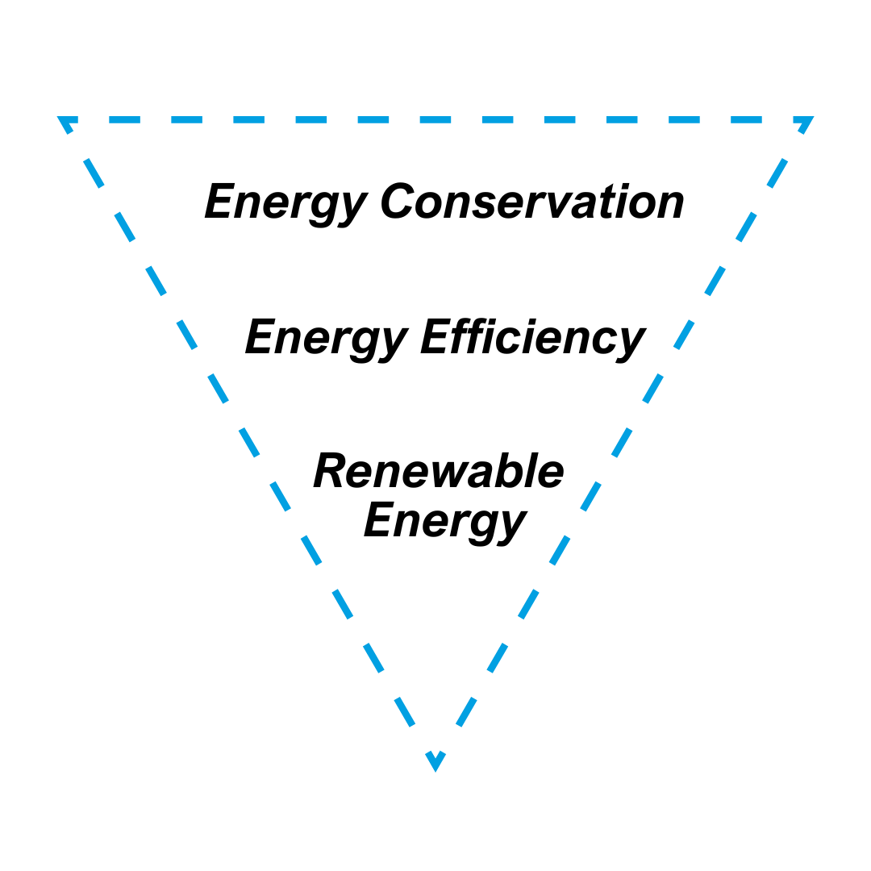
EPPH Energy Hierarchy
Example Energy Hierarchy Flow
Start here – Together we can attack the low hanging fruit. Examples of this would be ensuring windows and doors aren’t open when heating is on, sensors could be installed.
What next? – We then evaluate if efficiency of the heat source could be optimised. Examples of this would turning boiler flow down if heat emitters are sized accordingly.
Move to here – Once both the above have been maximised we can look to provide a cost and ROI for a renewable heat source such as a Heat Pump for a boiler.

Slide 19

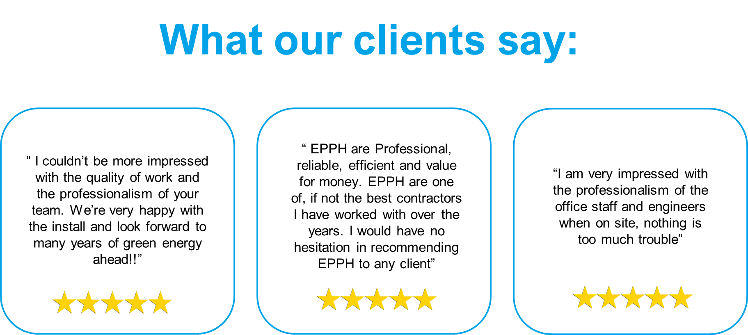

Slide 20
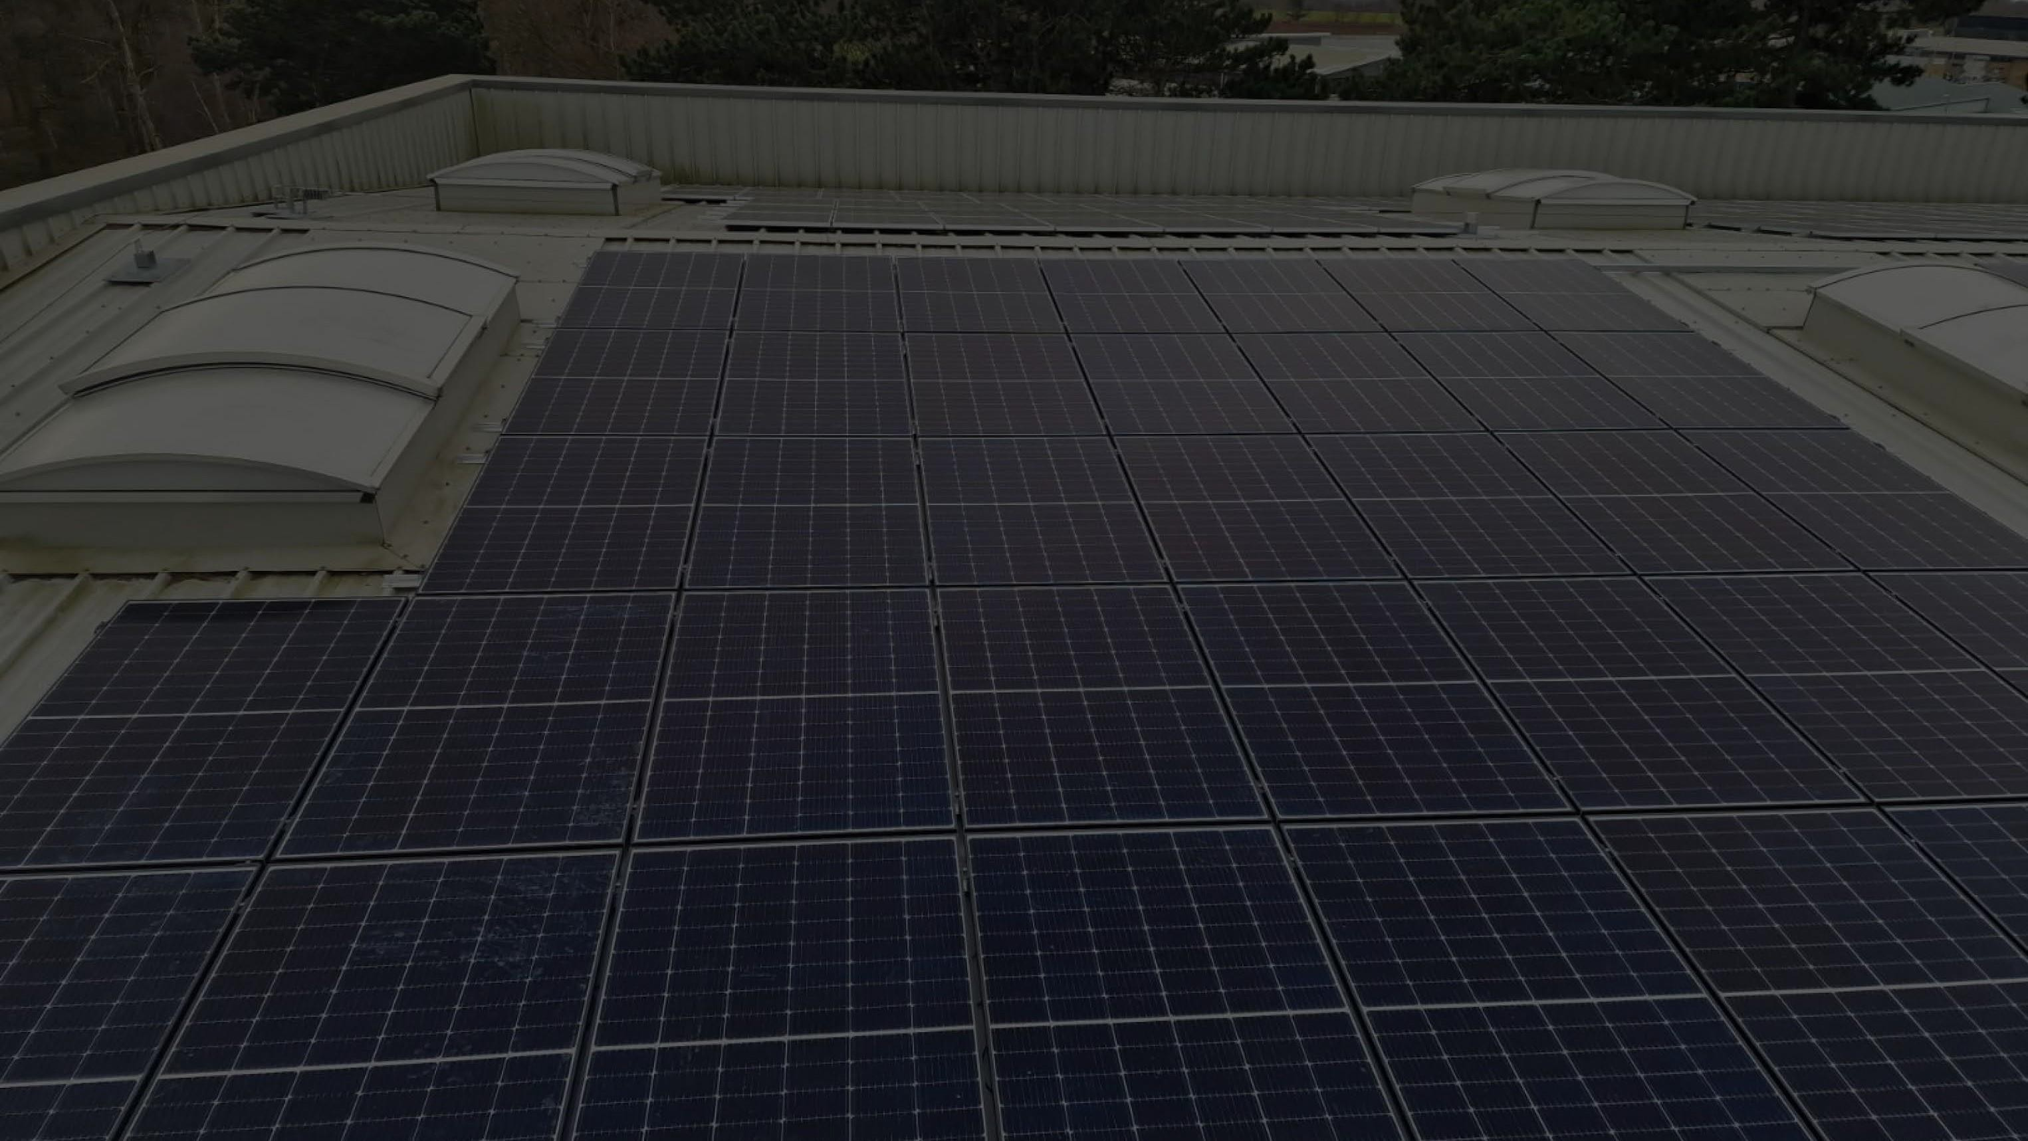




01473 559071
Info@epph.co.uk
Southern Branch - Units 20-21 Riverside Industrial Park, Rapier Street, Ipswich, Suffolk IP2 8JX
Northern Branch - Unit 12 City West Business Park, St Johns Road, Durham,DH7 8ER

